Slide 1
Computer Networks
Error Detection and Correction
& Media Access Control
Adrian Sergiu DARABANT
Lecture 6

Slide 2

The Data Link Layer
All People Seem To Need Data Processing

Slide 3
Handling Errors
Data can be corrupted during transmission
  Bits lost
  Bits changed
  Bits added
Frame additional data to protect
  Link-level addressing, seq no., etc
Handling ? – add redundant bits (data)

Slide 4

Error detection/correction scenario
Send D+EDC
Receive D’+EDC’

Slide 5
Detection vs Correction
Error Detection Techniques
  Allow for error detection but no possible correction
  Require frame re-transmission
  Used in low error rate transmission medias (fiber optics).
Error correction techniques (FEC)
  Involve more redundant data and processing power
  Used in high error transmission medias (radio)

Slide 6
Advantages/disadvantages of Error detection/correction
Error detection/correction techniques allow the receiver to sometimes but no always detect errors.
Undetected errors might still remain => corrupted packets delivered to the network layer.
Goal – have techniques that minimize the number of undetected errors

Slide 7
Detection/Correction Techniques
Parity Checks
Checksumming methods
Cyclic redundancy checks

Slide 8

Parity Checks
Parity Bit (PB)
  One additional bit per character
  Even parity
  Odd Parity

Slide 9
How many bit errors can PB detect ?
10001110 ---→ 10101110 => error !
10001110 ---→ 10100110 => No error detected !!!
Conclusion – 1 PB can only detect an odd number of errors !

Slide 10
Hamming Distance
Hamming distance = the number of bit positions in which two code-words differ.
How to calculate ?(Exclusive OR=XOR):
10001001
10110001
------------
00111000
=> The number of 1’s give the number of different bits.

Slide 11
Hamming and error detection
Error detection of d single-bit errors needs a d+1 distance code.
Example:
  BP has a distance of 2 => can detect single bit errors.

Slide 12
Bit Parity – YES or NO ?
Suppose a channel with BER: p=10⁻⁴ =>
P(sb error)=p
P(no sb error)=1-p
P(no error in 8 bits)=(1-p)⁸
P(undetected error in 8 bits)=1-(1-p)⁸
P(undetected error in 8 bits)=7.9x10⁻⁴

Slide 13
Bit Parity – YES or NO ? (2)
After adding a parity bit :
P(no sb error)=1-p
P(no error in 9 bits)=(1-p)⁹
P(sb error in 9 bits)=9xP(sb error)xP(no error in 8 bits) = 9p(1-p)⁸
P(undetected error in 9 bits)=1-P(no error in 9 bits)-P(sb error in 9 bits)
= 1-(1-p)⁹ - 9p(1-p)⁸
P(undetected error in 9 bits)=3.6x10⁻⁷
P(undetected error in 8 bits) 7.9x10⁻⁴
-----------------------------------=---------- ~=10³
P(undetected error in 9 bits) 3.6x10⁻⁷

Slide 14
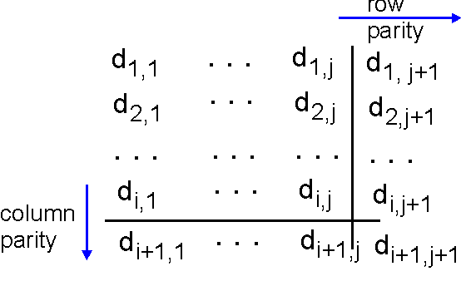
Single Bit Error Correction
Parity for each character(byte=line) + parity for each column (set of data bytes sent)

Slide 15
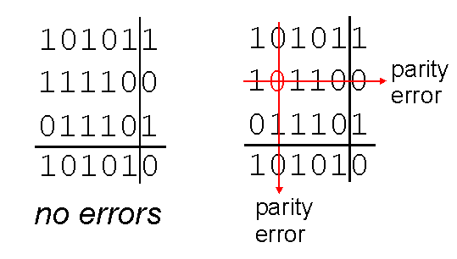
Example - Single Bit Error Correction
Hamming - Correctable single bit error

Slide 16
Correction vs Detection - Practice
Detection techniques
  For detecting d errors we need d+1 distance code.
Correction Techniques
  For correcting d errors we need 2d+1 distance code.

Slide 17
Error Correction
Valid codewords: 0000000000, 0000011111, 1111100000, and 1111111111
The Hamming distance of the code=5 => we can correct 2d+1=5 => d=2 bit errors.
0000000000---→0000000011 => the closest code is still 0000000000 !
0000000000---→0000000111 => the closest code is not correctly determined anymore !!

Slide 18
Hamming correcting code
Bits numbered from lsb to msb 1…n
Positions power of 2 = check bits => bits 1,2,4,8… etc check bits
Bit k from the sequence is checked by the positions from its binary decomposition k=11=1+2+8 => bits 1,2,8 are check bits

Slide 19
Hamming correcting code
In order to send 7 data bits we need 4 check bits.
Data: 1001101
Check bits 4 : 1,2,4,8
11 | 10 | 9 | 8 | 7 | 6 | 5 | 4 | 3 | 2 | 1
1 | 0 | 0 | x | 1 | 1 | 0 | x | 1 | x | x
sent as
1 | 0 | 0 | 1 | 1 | 1 | 0 | 0 | 1 | 0 | 1

Slide 20
Hamming correcting code
10011100101 is sent as 00011100101
=>the error bit is given by the indices that are in error
8=[11]+[10]+[9] – error =>k=8
4=[7]+[6]+[5] – ok =>k=8
2=[11]+[10]+[7]+[6]+[3]–error=>k=10
1=[11]+[9]+[7]+[5]+[3]-error =k=11

Slide 21

Checksum Codes
soh | data | eot | Checksum
Byte stream interpreted as series of numbers (16 bit integers)
Integers are added =>checksum appended to the frame.
Receiver calculates again the checksum and discovers the errors.

Slide 22
Errors Checksum fails to detect
Data Item Binary | Checksum Value
0001 | 1
0010 | 2
0011 | 3
0001 | 1
Total | 7
Data Item Binary | Checksum Value
0011 | 3
0000 | 0
0001 | 1
0011 | 3
Total | 7
Second bit inverted for each value
Checksum is the same

Slide 23
Cyclic Redundancy Check (CRC)
Bit strings represented as polynomials with coef. 0 and 1.
K bit frame =>x^{k-1}+…+1 (first and last coef must be 1)
Example
  110001 => x⁵+x⁴+1
Polynomial arithmetic is done module 2 i.e. ⬄ addition/subtraction = XOR operation

Slide 24
CRC (2)
Sender (S) and Receiver (R) agree on a generator polynomial G(x)
Frame – m bits => M(X) – the checksum of m is the remaining of R(x)=M(x)/G(x)
Checksum added to frame.
(R) Gets the frame M’(x)=[M(x)-R(x)]
  If M’(x)/G(x) has remainder => error

Slide 25
CRC (3)
Frame m bits. Generator r bits.
Calculate: x^{r} M(x) – m+r bits
x^{r}M(x) / G(x) – take remainder R(x)
Send: T(x) = x^{r}M(x) – R(x)
Receiver: T(x) should be divisible with G(x). If not we have transmission errors.
soh | data | eot | CRC

Slide 26
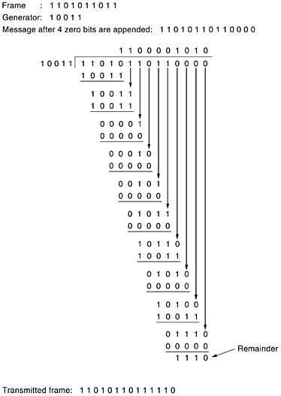
CRC - Example
Frame – 1101011011
G(x)=x⁴+x+1
Transmitted frame:
11010110110000 –
00000000001110
----------------------
11010110111110

Slide 27
CRC (4)
(S) – sends T(x)=M(x)-R(x)
(R) – receives T(x)+E(x). T(x)/G(x)=0 and E(x)/G(x) – gives the error.
If E(x)=P(x)G(x) => undetected error !!!!
E(x)=x^{i} , Generally G(x) is multiple term => E(x)/G(x)≠0 All Single-Bit errors detected !
E(x)=x^{i}+x^{j}=x^{j}(x^{i-j}+1) – detected. See (2)
E(x) – has odd number of terms. If G(x)=(x+1)G’(x) => any odd number of errors are detected.

Slide 28
CRC (5)
IEEE 802 uses:
x³²+x²⁶+x²³+x²²+x¹⁶+x¹²+x¹¹+x¹⁰+ x⁸+ x⁷+ x⁵+ x⁴+ x²+ x¹+1
Catches all ≤ 32 bit error bursts and all odd length error bursts.

Slide 29
Medium Access Control
Requirements for a broadcast channel:
Give everyone a chance to speaks
Don't speak until you are spoken to
Don't monopolize the conversation
Raise your hand if you have question
Don't interrupt when someone is speaking
Don't fall asleep when someone else is talking

Slide 30
Channel Allocation Problem Model
Station Model – N stations generating frames within Δt with probab. λΔt.
Single Channel
Collision Assumption
Time
  Continuous Time
  Slotted Time
Carrier
  Carrier Sense
  No Carrier Sense

Slide 31
Solution – Multiple Access Protocol
Access protocol requirements for a R bps channel:
When only one node has data to send, that node has a throughput of R bps.
When M nodes have data to send, each of these nodes has an avg. throughput of R/M bps
The protocol is decentralized, i.e., there are no master nodes that can fail and bring down the entire system
The protocol is simple, so that it is inexpensive to implement

Slide 32
Multiple Access Protocols
Channel Partitioning
Random Access Protocols

Slide 33
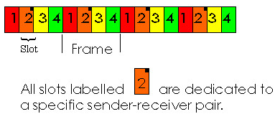
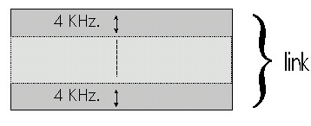
Channel Partitioning
FDM
Frequency Division
Multiplexing
TDM
Time Division Multiplexing

Slide 34
Random Access Protocols
ALOHA
  Pure Aloha
  Slotted Aloha
CSMA (Carrier Sense Multiple Access)
  CSMA
  CSMA/CD – with collision detection

Slide 35
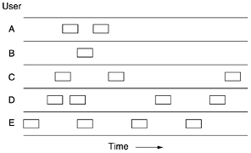
ALOHA
Users send data whenever they want
Two frames on the same channel – collision=> both frames are destroyed

Slide 36
CSMA
1-Persistent CSMA
Non-Persistent CSMA
P-persistent CSMA

Slide 37
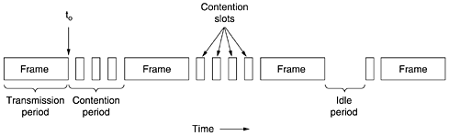
CSMA/CD
Sense the channel
Stop sending when detecting collision
After collision wait a random amount of time and try again.

Slide 38
Readings
Computer Networks (A, Tannenbaum) – Chapters 3,4
Computer Networks: A top Down Approach Featuring the Internet – Chapter 5

